Slide 1

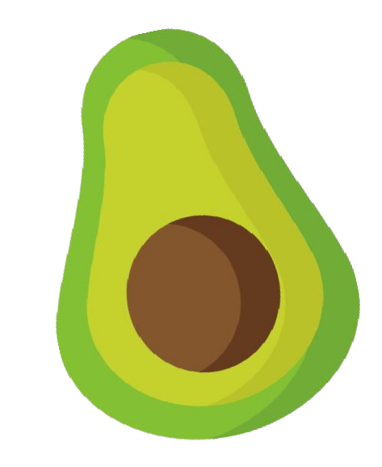




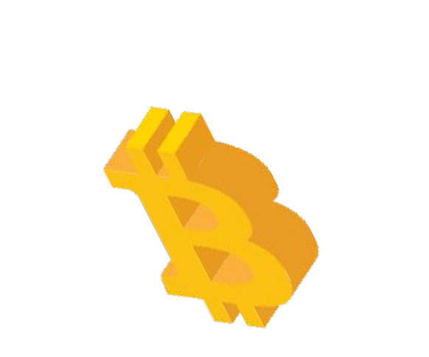
WHY MONEY CONVERGES TO ONE
n(n-1)/2
ANIL PATEL

Slide 2
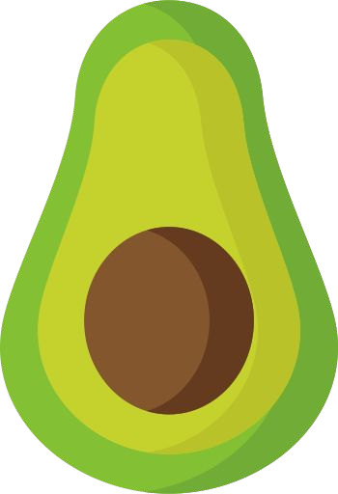


@ANILsAIDsO
Exchanging one good or service for another is a process known as barter exchange.

Slide 3


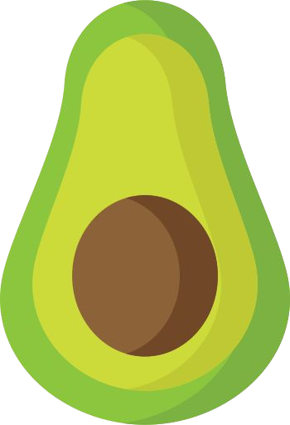



@ANILsAIDsO
Barter can work at small scales. Let’s look at an example with 6 items.

Slide 4
@ANILsAIDsO
1
9
10
6
7
12
2
8 11
13
14
5
3
15
4
An economy of 6 items requires keeping track of 15 different exchange rates.

Slide 5
n(n-1)/2
2 items = 1 exchange rate
6 items = 15 exchange rates
500 items = 124,750 exchange rates
But an economy with just 500 items will have 124,750 exchange rates, making the barter system infeasible for a complex economy of millions of items.

Slide 6
This problem of a coincidence of wants is solved by using a single common medium between all transactions.
@ANILsAIDsO
Usually, the most tradable good in a society is termed money.

Slide 7

@ANILsAIDsO
Previously, this was decided by the free-market. Based on a good’s monetary properties.
SCARCITY
DIVISIBILITY
PORTABILITY
DURABILITY
RECOGNIZABILITY

Slide 8

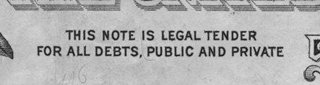
@ANILsAIDsO
Today, it’s a top-down phenomena, imposed on citizens by sovereign governments.

Slide 9
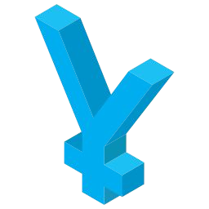
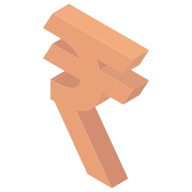



@ANILsAIDsO
Money may differ in different places if there are significant enough barriers between them.

Slide 10
@ANILsAIDsO
In the case of sovereign nations, a few things help create barriers and ensure a monetary monopoly: physical borders, capital controls, legal tender laws

Slide 11
@ANILsAIDsO
But we now have a global digital communications network (the internet).
This is breaking down borders and creating a single market, enabling international commerce at the level of the individual.

Slide 12


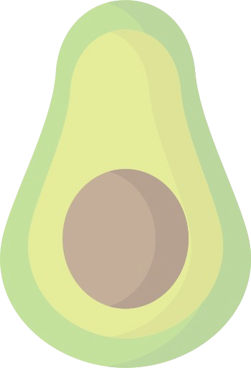



@ANILsAIDsO
We now come across a similar version of our barter problem, but this time with the currencies themselves.

Slide 13
@ANILsAIDsO
And once again we'll converge, this time on a single global monetary medium.

Slide 14
@ANILsAIDsO
The chosen medium to bridge this gap will need to be:
Neutral (no single group has seigniorage)
Global (accessible everywhere)
Transparent (anyone can verify & audit)
Indestructible (cannot be shut down)
Peer-to-peer (enable commerce at the individual level)

Slide 15
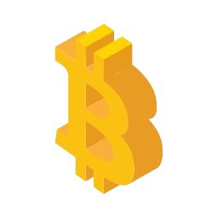








MONETARY
PROPERTIES
@ANILsAIDsO
By assessing the relative properties of all monetary goods, a winner emerges and the market converges.

Slide 16
@ANILsAIDsO
Right now, all evidence points to that being bitcoin.

Slide 17
@ANILsAIDsO
But it doesn’t end at simply intermediating currency exchanges.
Ultimately, we end up with a global economy, bypassing jurisdictionally-restricted money, transacting through one common digital monetary medium.

Slide 18
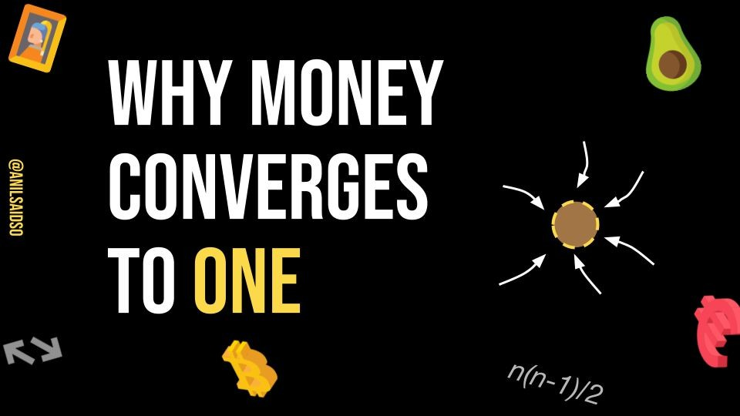







Fantastic thread!
—Gigi
Love this! Well done!
—Matthew Dellavedova
Great explanation why bitcoin will be the only digital money.
—Pavol Rusnafi
Read this thread before wasting your time with "crypto".
—Giacomo Zucco
Available in:
Gumroad

Slide 19
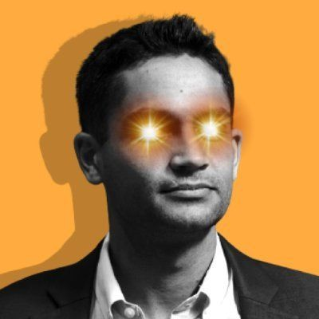

Enjoy the journey down the rabbit hole.
Thanks for reading.
Anil
@anilsaidso

